Slide 1
Brute Force Lab

Slide 2
Brute Force Lab
Materials needed
Kali Linux Virtual Machine
Software Tool used
JTR (John the Ripper)
Password cracking tool (pre-installed on Kali OS)

Slide 3
Objectives Covered
Security+ Objectives (SY0-501)
Objective 1.2 – Compare and contrast types of attacks
Cryptographic Attacks
Brute Force
Objective 2.2 – Given a scenario, use appropriate software toold to assess the security posture of an organization
Password cracker
DHS CAE Units
CTH – Describe different types of attacks and their characteristics

Slide 4
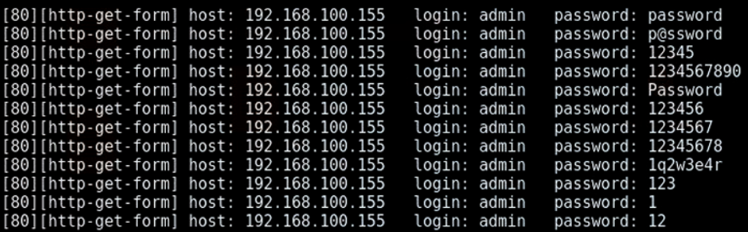
What is a Brute Force Attack?
A brute force attack is a form of password attack where the attack attempts to guess a password by trying many passwords in the attempt to guess the correct password
Notice all the passwords being used in hopes of finding the right password for the system

Slide 5
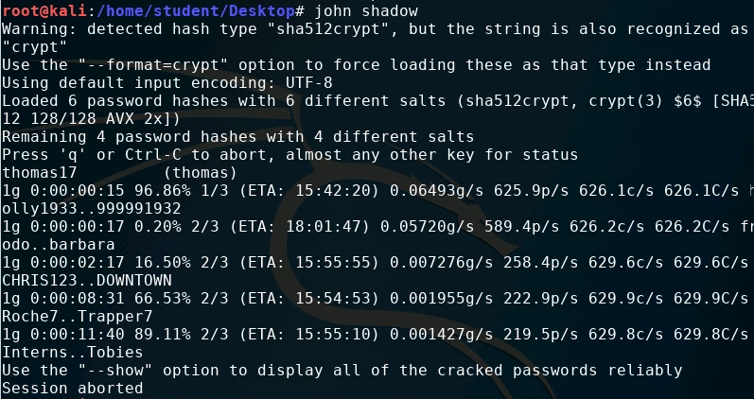
The Brute Force Lab
Setup Environment
Create example users
Set example passwords
Locate password file
Launch the Attack
More Hashes
Observe results

Slide 6
Setup Environment
Log into your range
Open the Kali Linux Environment
You should be on your Kali Linux Desktop

Slide 7
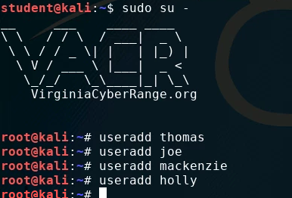
Create Users
Login as the root user with the following command:
sudo su -
Notice the command prompt is now root@kali
Create additional users by using the following command:
This command creates a user named “thomas”
useradd thomas
Create at least 3 users
Remember the users' names - you will need these to set passwords for them

Slide 8
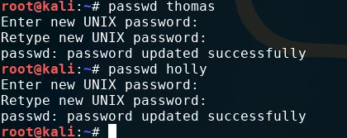
Set passwords
Use the following command to set a password for each account:
The following command starts the prompt to set a password for the user thomas
passwd thomas
Enter the password at the prompt “Enter new UNIX password:”
Set the password to be one from the list of the names you added to the dictionary file earlier!
Repeat this step for all user accounts you created.

Slide 9
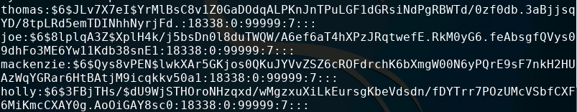
Locate Hashed Passwords
Navigate to the etc directory:
cd /etc
The file passwd contains all the usernames on the system (See the accounts you created?)
In older systems, the password for each user was stored in the passwd file (That's why it's named that) - NOT a secure way of storing passwords!

Slide 10
Locate Hashed Passwords
Linux switched over to hashing passwords and storing them in a file named shadow
Use the following command to see the hashed passwords in the shadow file:
cat shadow
Copy the shadow file to your Desktop using the following command: cp shadow /home/student/Desktop

Slide 11
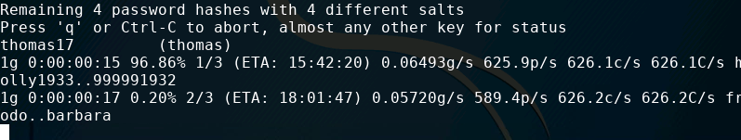
Launching the JTR Attack
In order to launch the attack, use the following command:
john shadow
This will run John the Ripper on the shadow file and start working to crack the passwords
Press space while the attack is working to see what passwords John the Ripper is currently trying
Note this will take some time, depending on the strength of the passwords

Slide 12

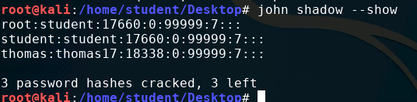
Seeing the Results
Notice that a found password will display the result while JTR is running
The following example found “thomas17” to be the password for the user “thomas”
Not a very secure password was it?
You can wait for JTR to finish, or press CTRL+C to stop the attack.
The following command will show all the passwords that have been solved
john shadow --show

Slide 13
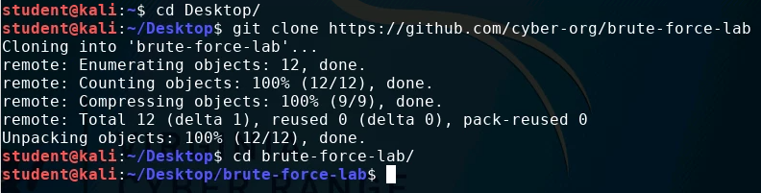
More Hashes
Open a new Terminal and navigate to the Desktop
cd Desktop
Download more hashes to crack
git clone https://github.com/cyber-org/brute-force-lab
Navigate into the directory
cd brute-force-lab

Slide 14
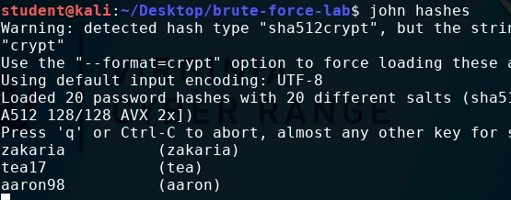
More Hashes
Display the hashes
cat hashes
Notice there are 20 password hashes
Crack the hashes
john hashes

Slide 15
How to Defend Against a Brute Force Attack?
Strong Passwords
Why is a longer password stronger? (D0e5 w31rd sp3LLing M4tt3r?)
Why were some passwords solved before others?
Increasingly longer delay between failed attempts
Slow down the attacker. (10s, 15s, 30s, 45s, 1minute between attempts.)
Lockout after __ failed attempts
Account will eventually lock. User will need contact support to regain access.
Two-Factor Authentication
Why would these help secure your password?
What are some other ways of defending against a brute force attack?

